Slide 1
DATA SCIENCE PRESENTATION
Crop Statistics
Dataset link:
https://www.kaggle.com/raghavramasamy/crop-statistics-fao-all countries

Slide 2
DATA COLLECTION
Dataset on Countries-wise Crop Production across the world from 1961 to 2019
Doing an exploratory data analysis of this dataset would give insights into World agriculture status: country-wise, crop-wise and levels of productions. A complete analysis will paint a beautiful story of this important aspect of World.
Dimensions of the dataset is 1048575 rows and 11 columns.
Dataset contains 174 crops cultivated across over 120 Countries from 1961 to 2019.

Slide 3
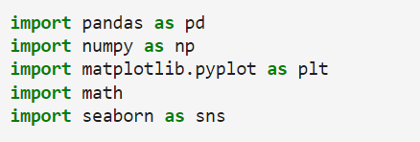
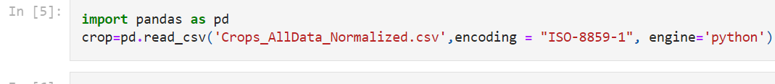
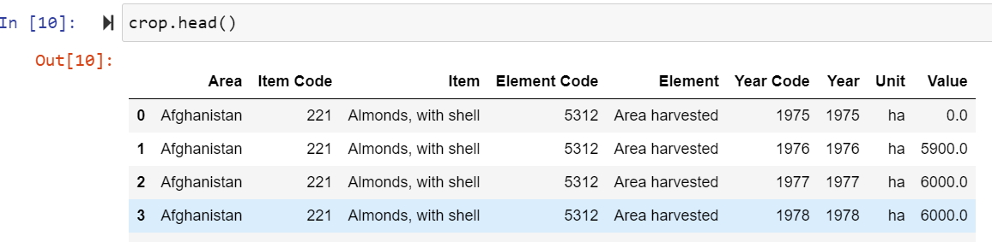
INTRODUCTION TO DATASET
(Reading Our Dataset)

Slide 4
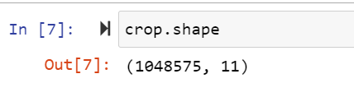
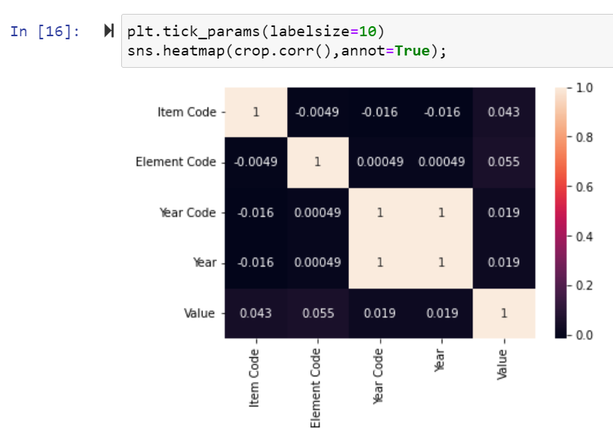
By dropping missing values in Production variable we ended up with 1048575 sample size.
9
Checking for Correlation between variables
In our dataset there is no variable showing high correlation with any other variable.

Slide 5
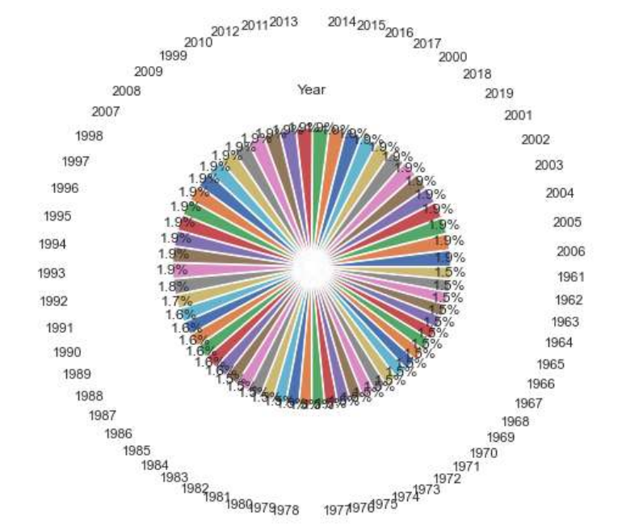
Year wise percentage crop cultivation

Slide 6
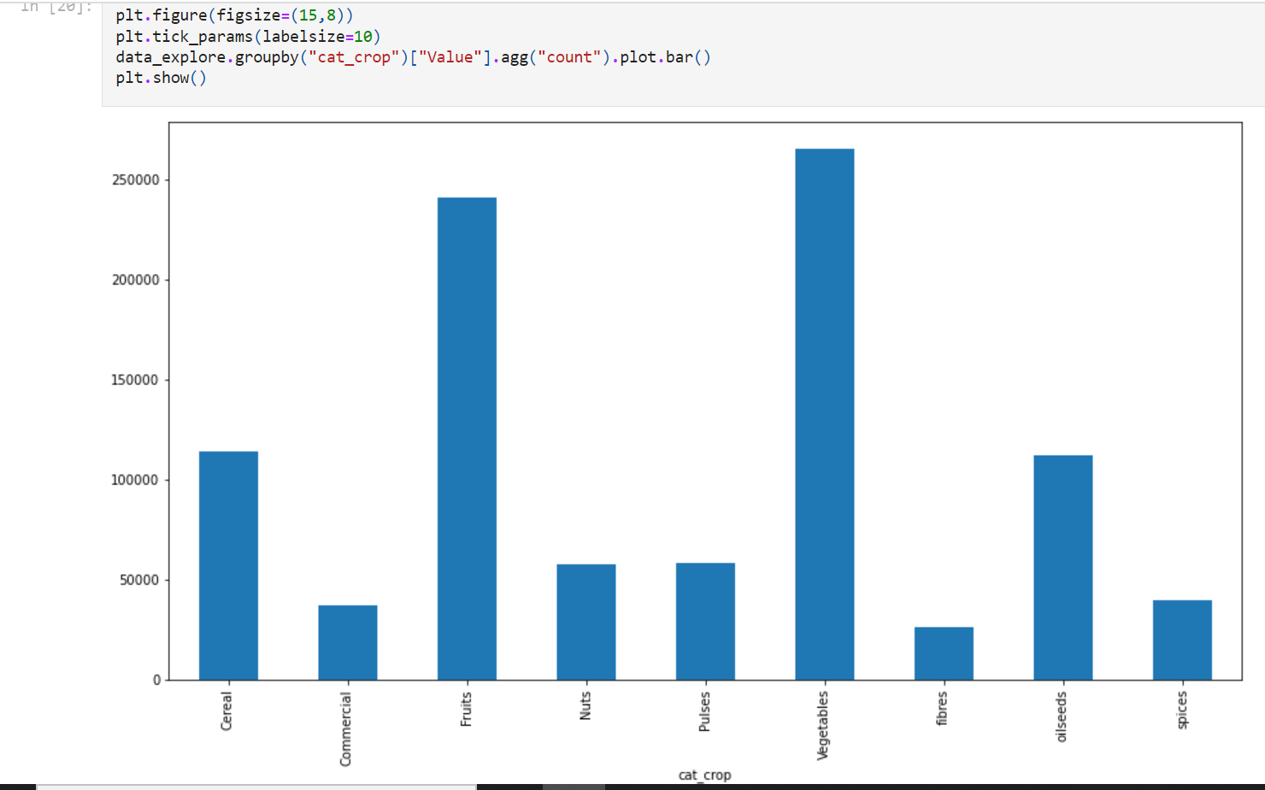
Crop wise Production plot describing production values for all crop types.

Slide 7
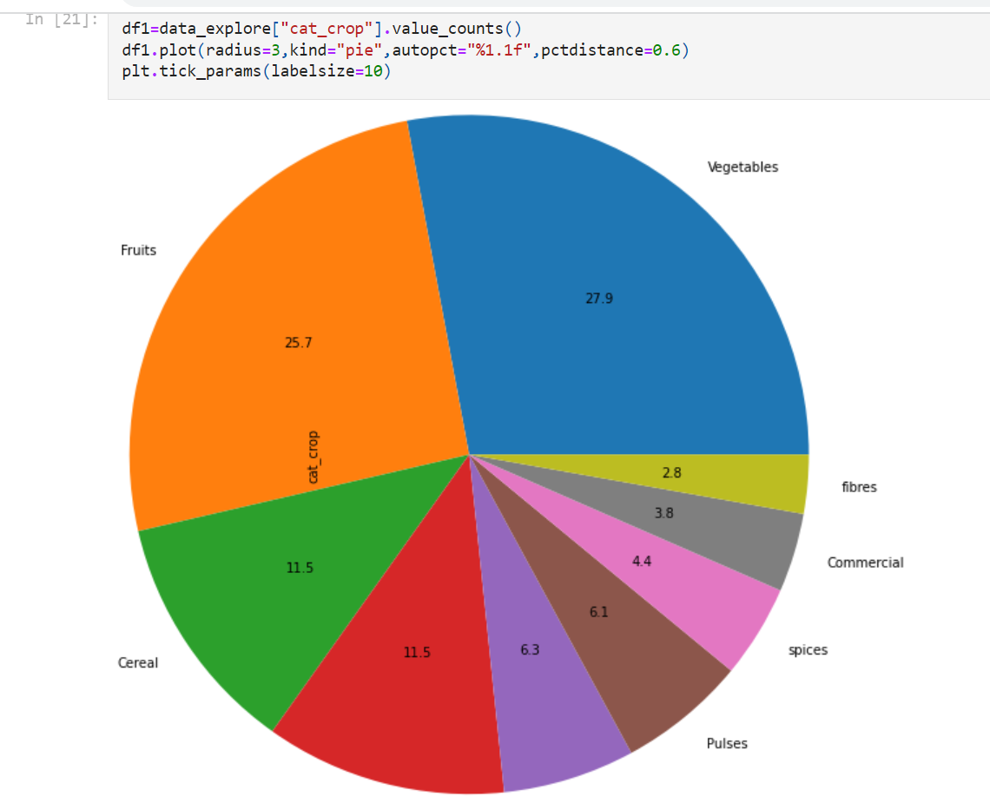
Pie Chart of different categories of crops
Among all countries Vegetables are most cultivated followed by Fruits and Cereal.

Slide 8
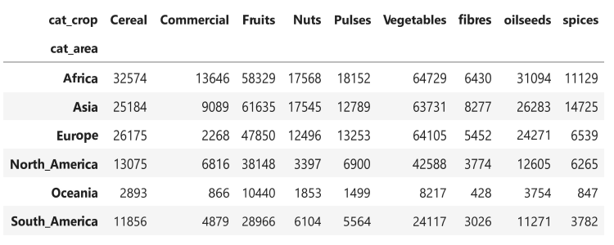
For Continents wise visualization, we categories countries into their continents

Slide 9
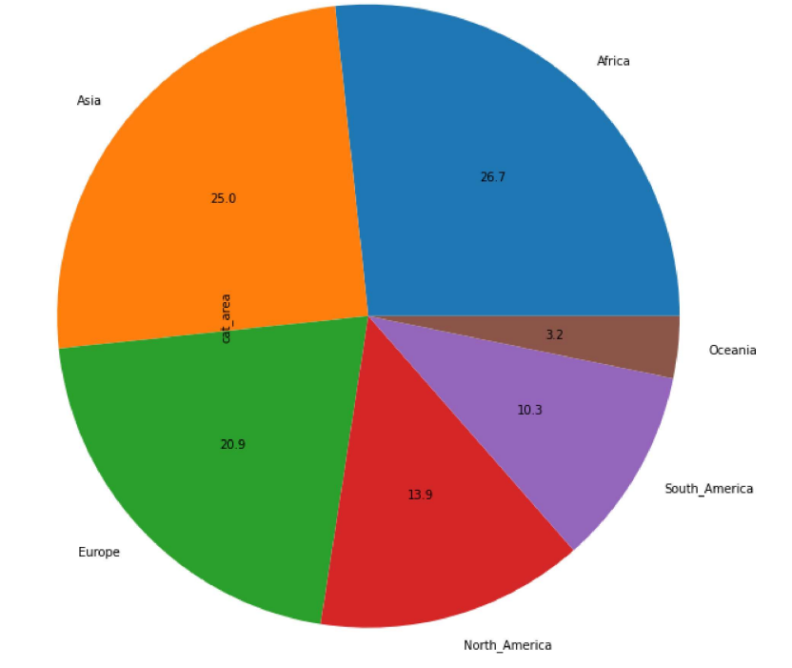
Pie Chart showing the percentage of crops cultivated in all Continents
Among all continents, Africa is the leading continent in crop cultivation followed by Asia and Europe.

Slide 10
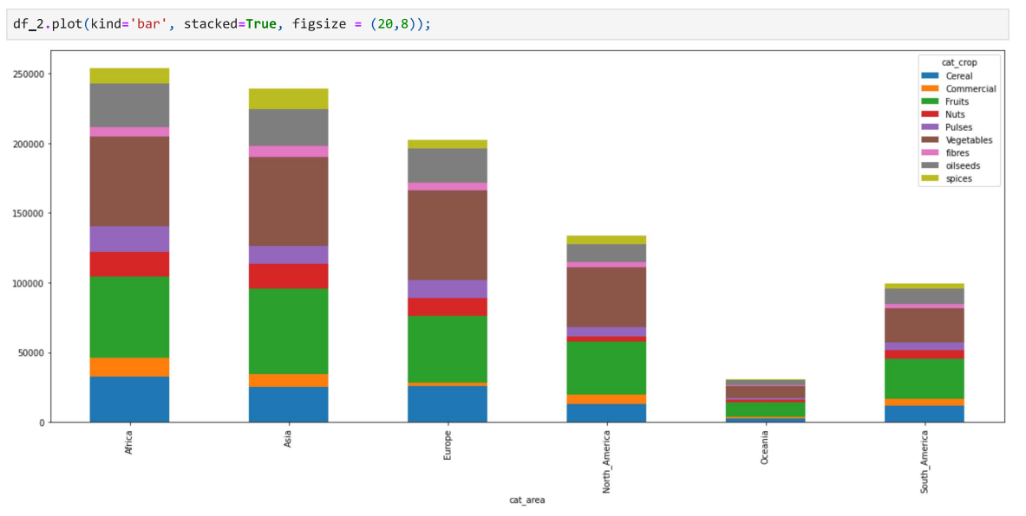
Crop Counts Vs Continents

Slide 11
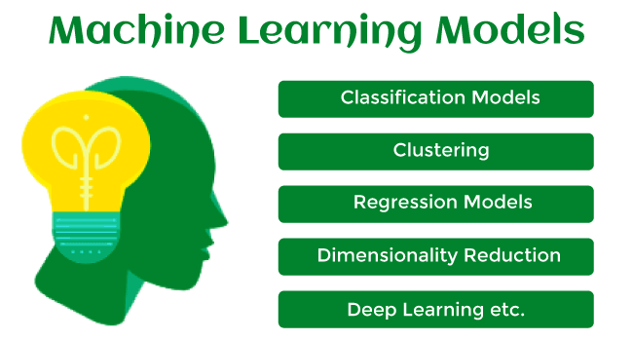
PREDICTION TASK USING MACHINE LEARNING MODEL
Machine learning model can be understood as a program that has been trained to find patterns within new data and make predictions.
Various machine learning models are

Slide 12
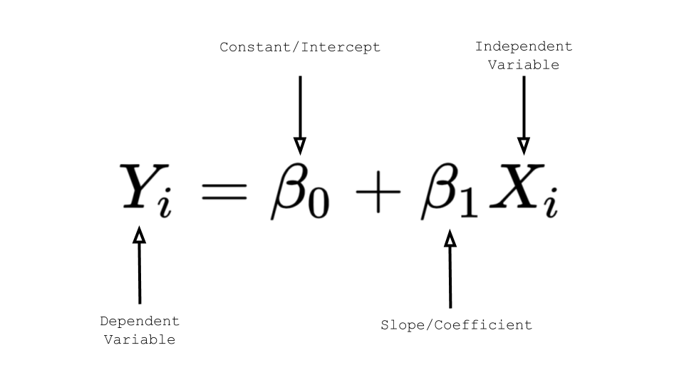
LINEAR REGRESSION MODEL
Linear Regression is the supervised machine learning model in which the model finds the best fit linear line between the independent and dependent variables.
It finds the linear relationship between the dependent and independent variable.
Equation of Regression Line

Slide 13
GROUP- 36
Kaivalya Gupta ( Group representative ) ( 2001CB29 )
Amrit Kumar ( 2001CB06 )
Aditya Jha ( 2001CB05 )
Rahul Kumar ( 2001CB42 )
Sunny Kumar ( 2001CB56 )
Jaykumar Gupta ( 2001CB28 )

